Slide 1
Unit-8
Graph

Slide 2
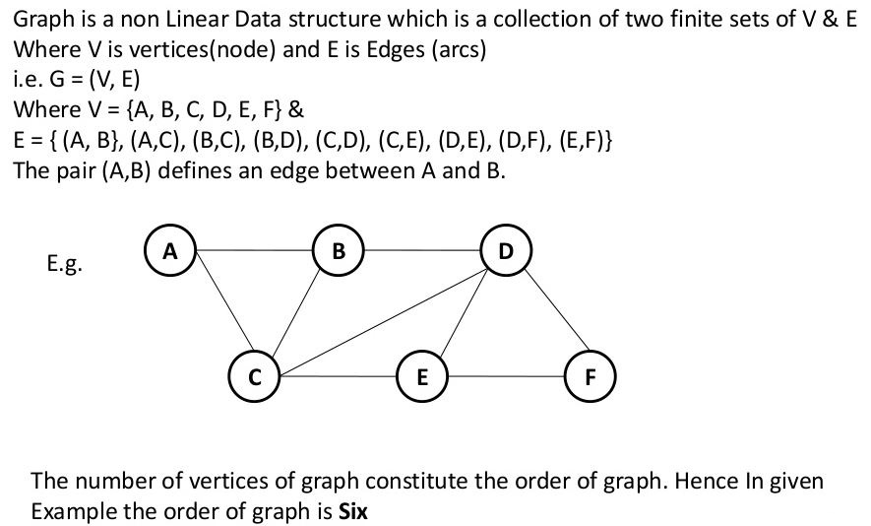

Slide 3
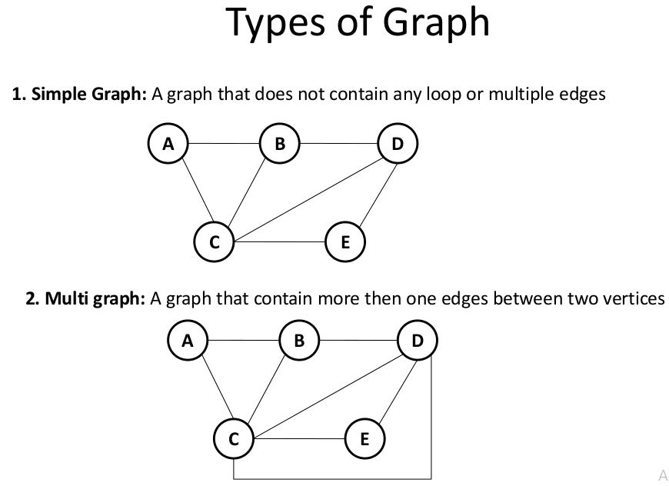

Slide 4
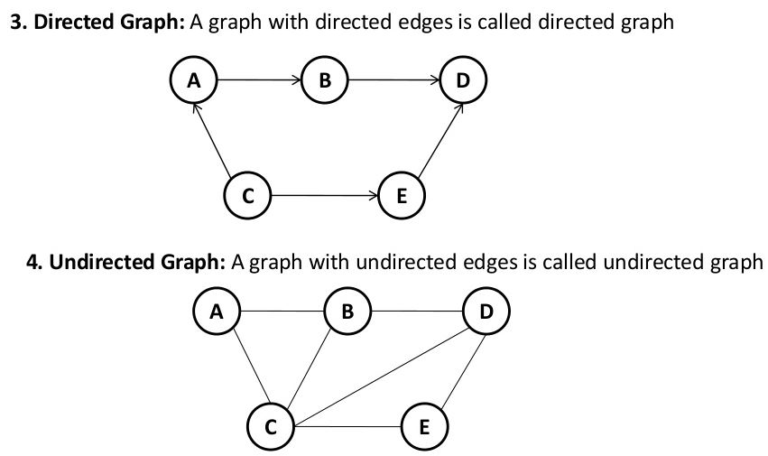

Slide 5
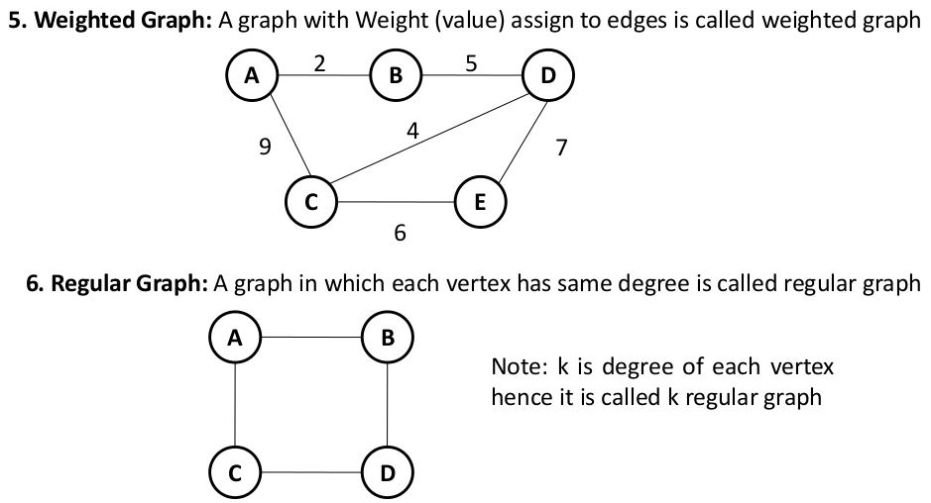

Slide 6
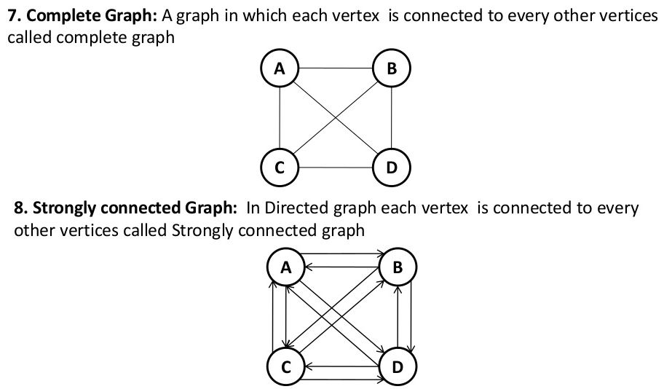

Slide 7
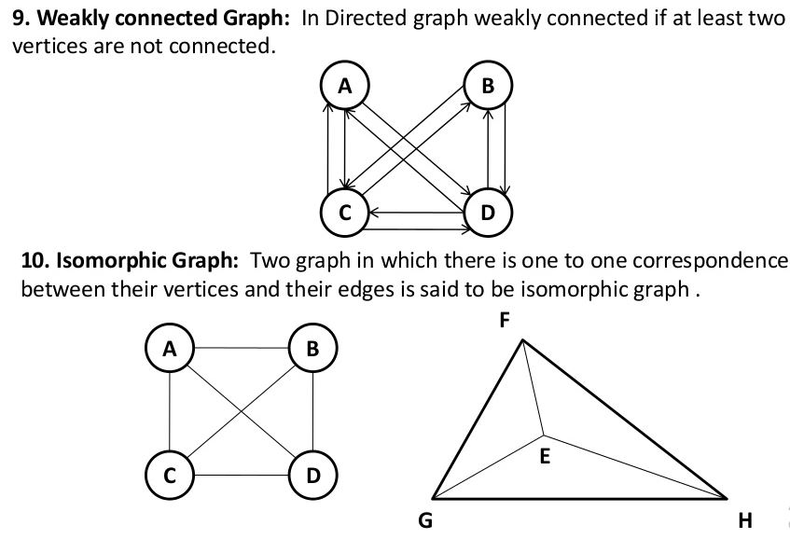

Slide 8
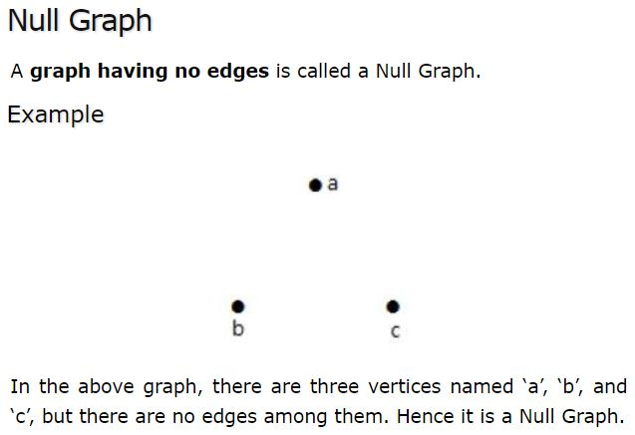
11.

Slide 9
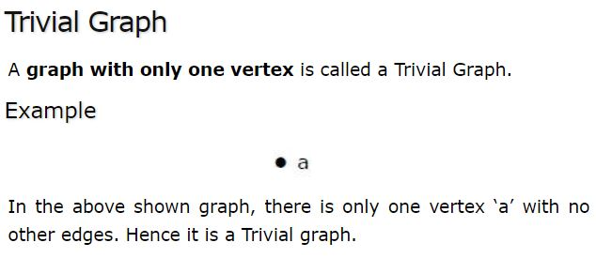
12.

Slide 10
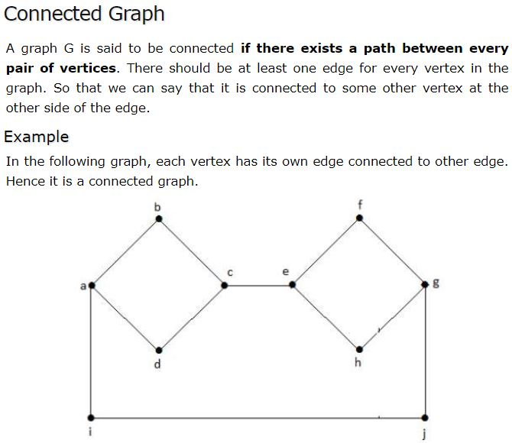
13.

Slide 11
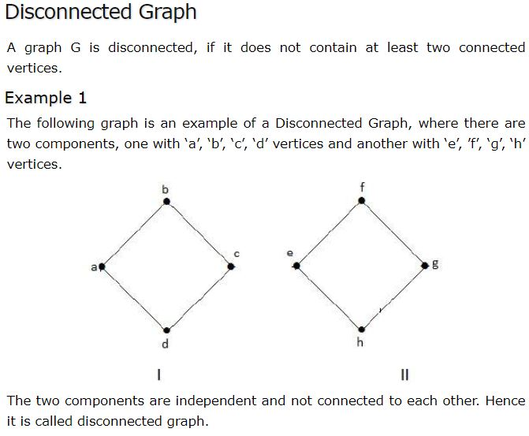
14.

Slide 12
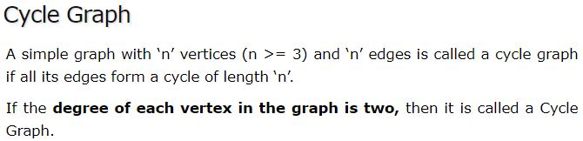
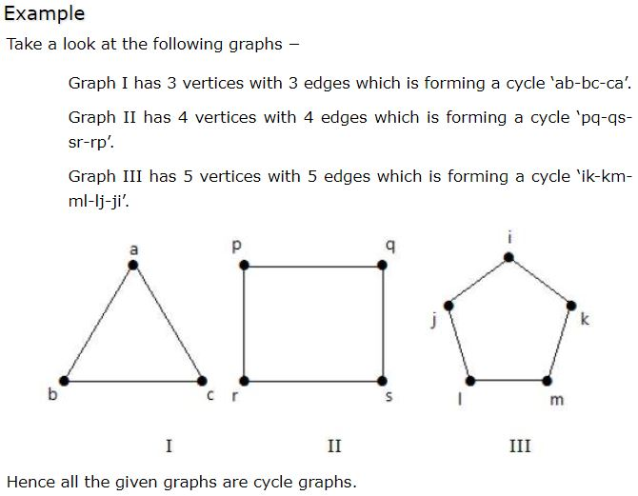
15.

Slide 13
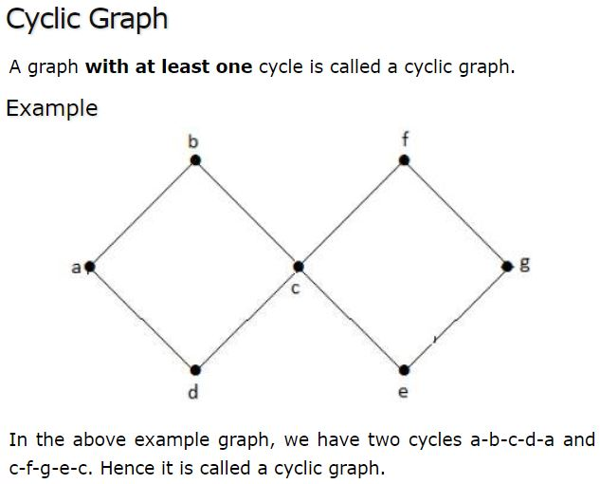
16.

Slide 14
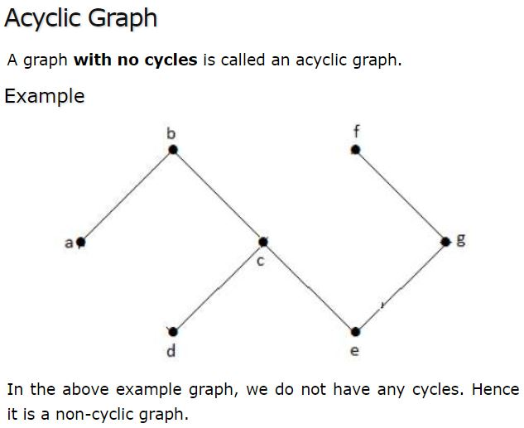
17.

Slide 15
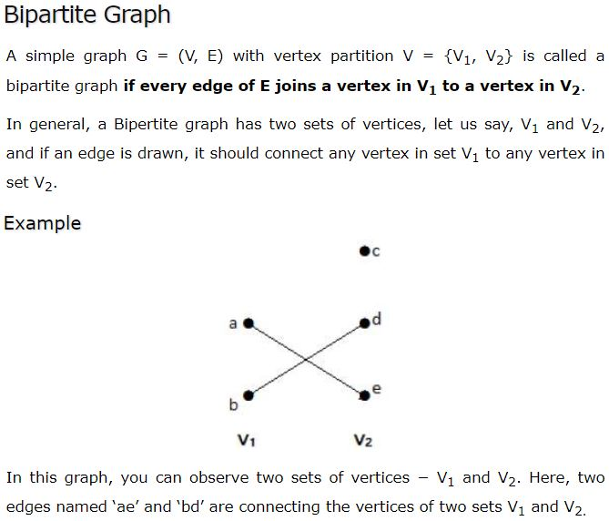
18.

Slide 16
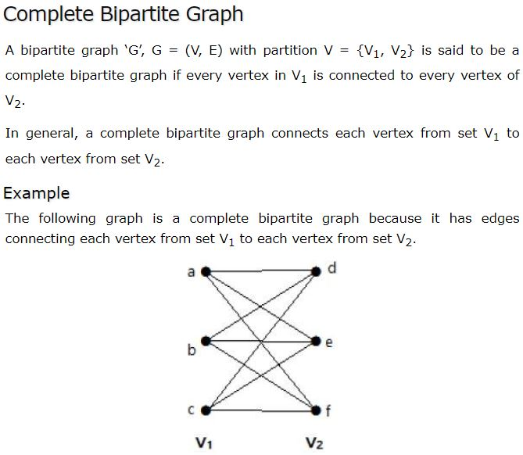
19.

Slide 17

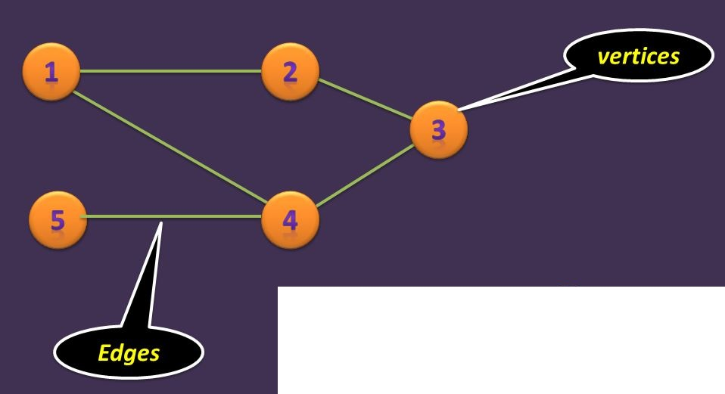
Graph Terminologies:
Edge: It is also called a arc.

Slide 18
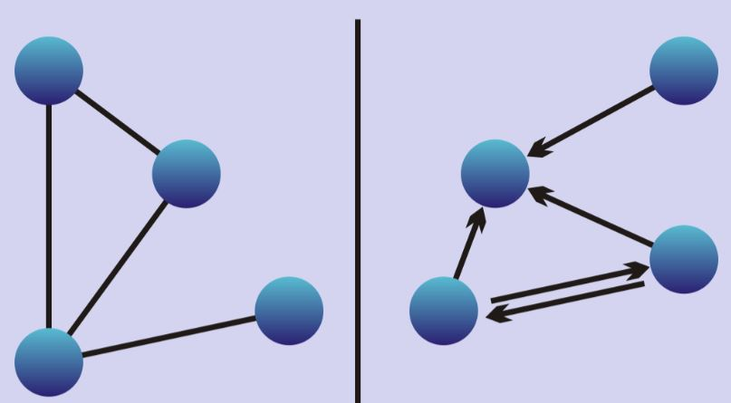
Fig: Undirected Edge
Fig: Directed Edge

Slide 19
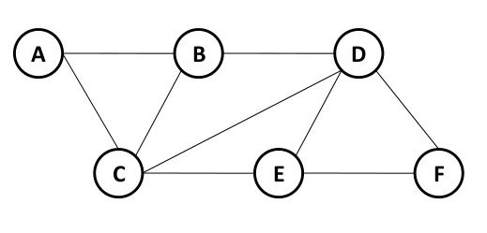
2. Vertex:
A vertex is a point where multiple lines meet.
A vertex is also called a node in graph.
A, B, C, D, E, F are vertices in a Graph ‘G’.
Fig 1: Graph ‘G’

Slide 20
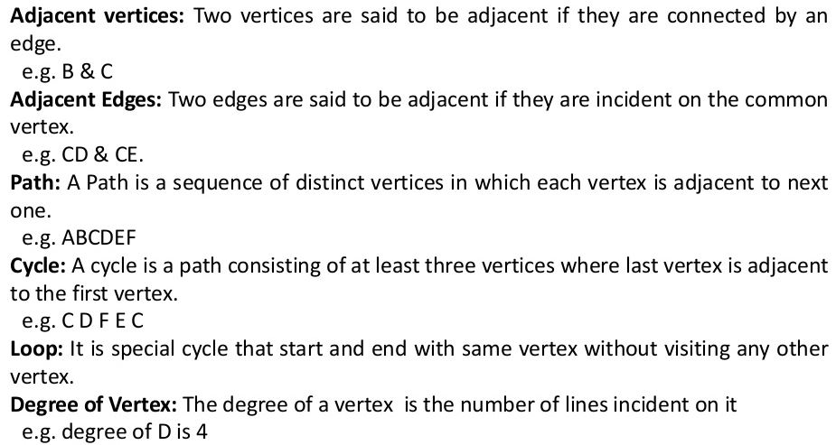
3.
In Fig 1: Graph ‘G’
4.
In Fig 1: Graph ‘G’
5.
In Fig 1: Graph ‘G’
6.
In Fig 1: Graph ‘G’
7.
8.
In Fig 1: Graph ‘G’

Slide 21
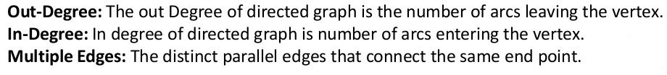
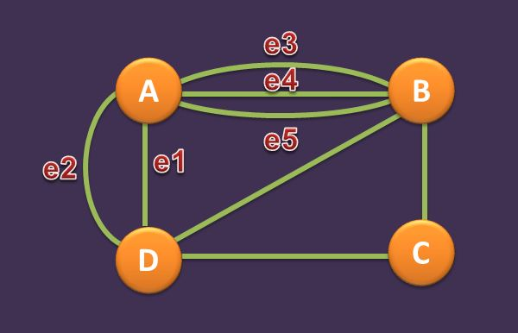
9.
10.
11.
Fig: Multiple Edges

Slide 22
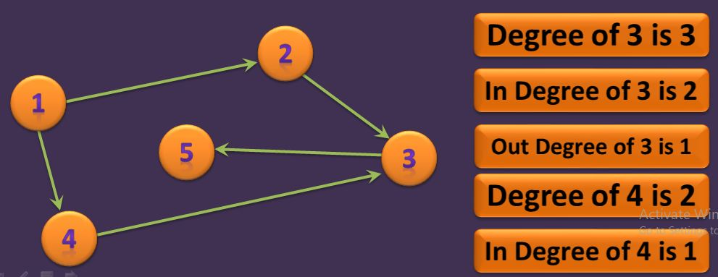
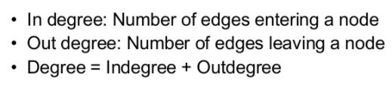

Slide 23
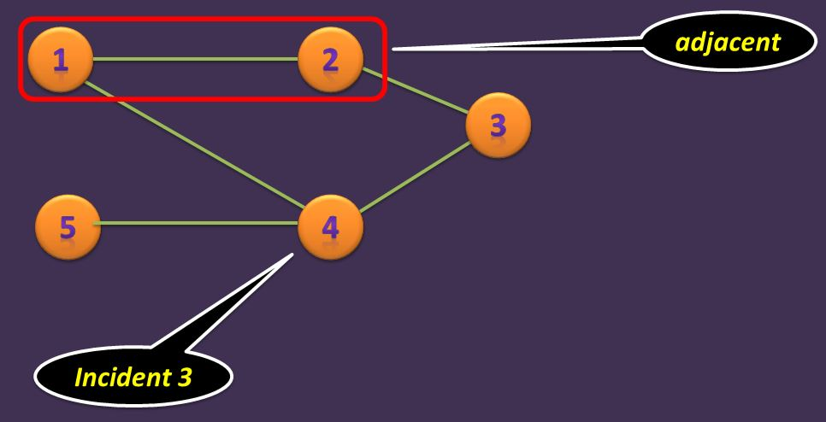

Slide 24
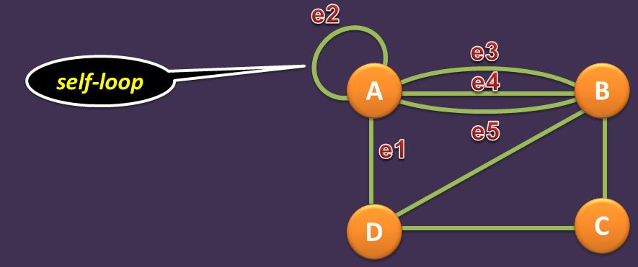

Slide 25
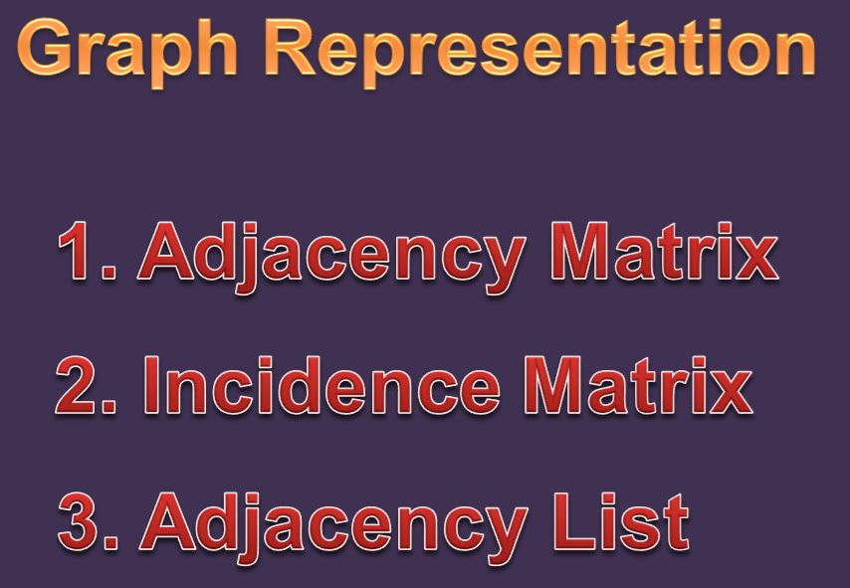

Slide 26
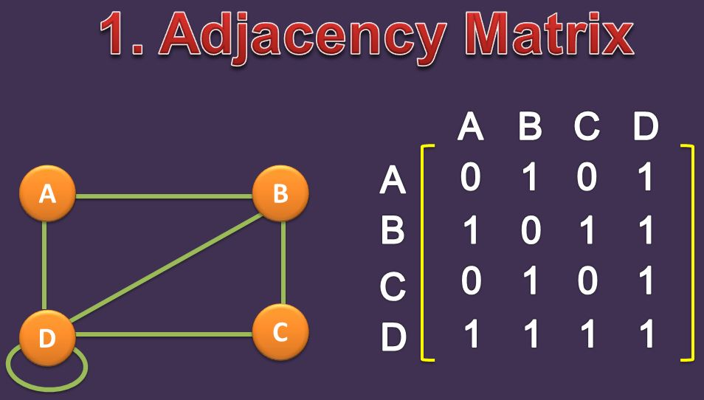
In Undirected Graph

Slide 27
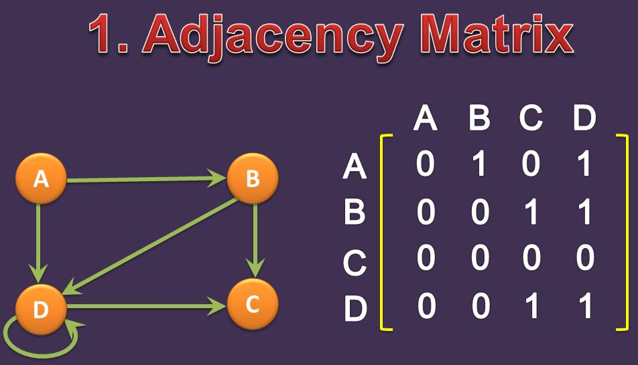
In Directed Graph

Slide 28
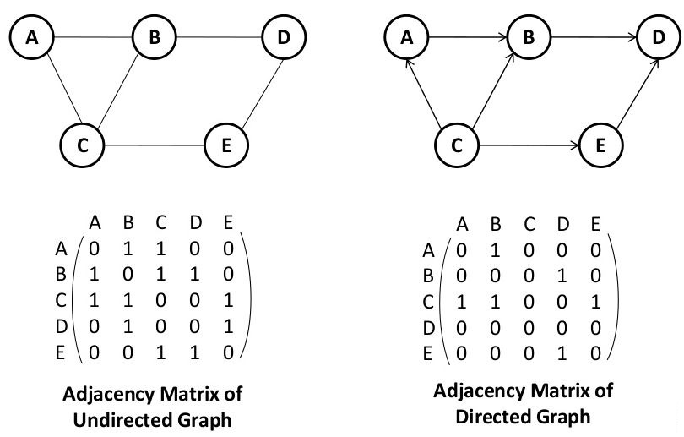

Slide 29
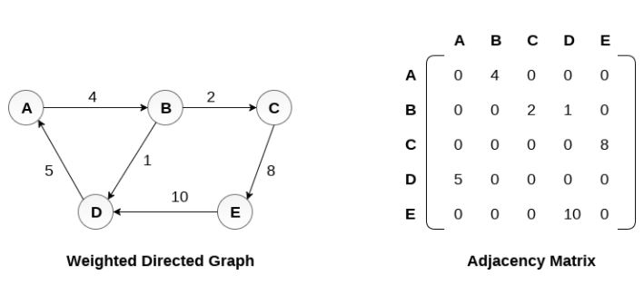

Slide 30
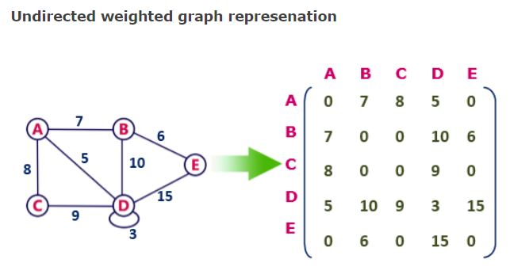

Slide 31
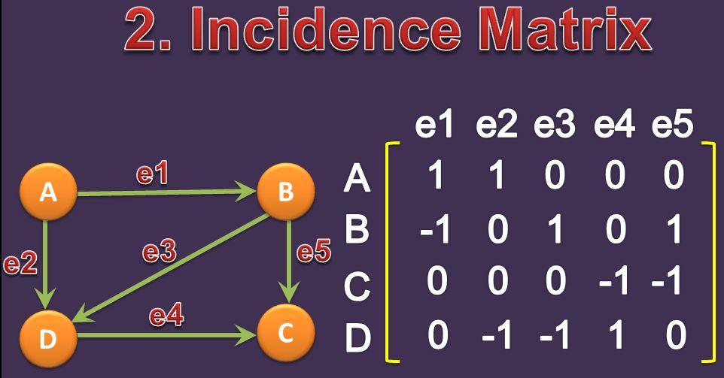

Slide 32
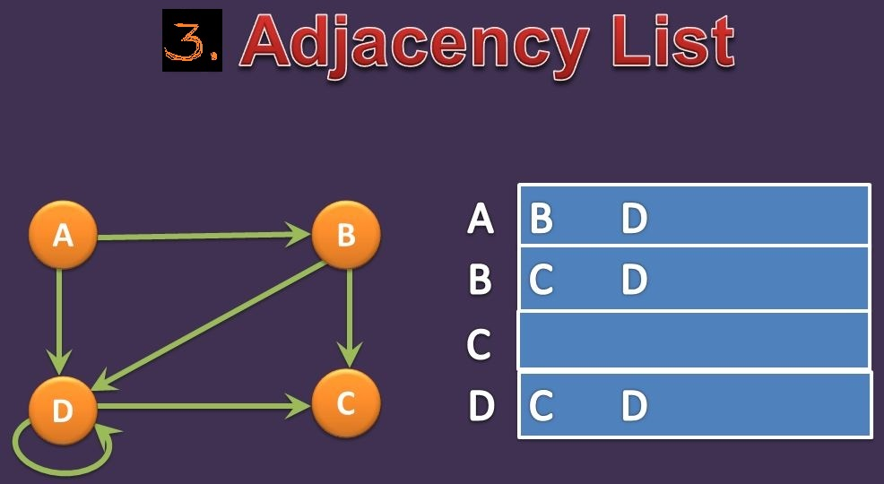
Array Representation

Slide 33
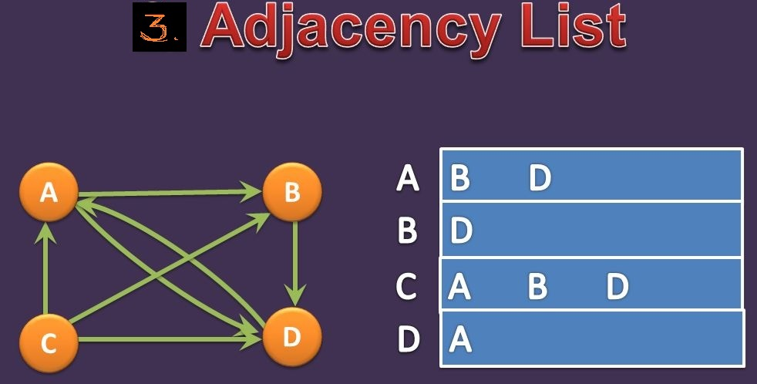
Array Representation

Slide 34
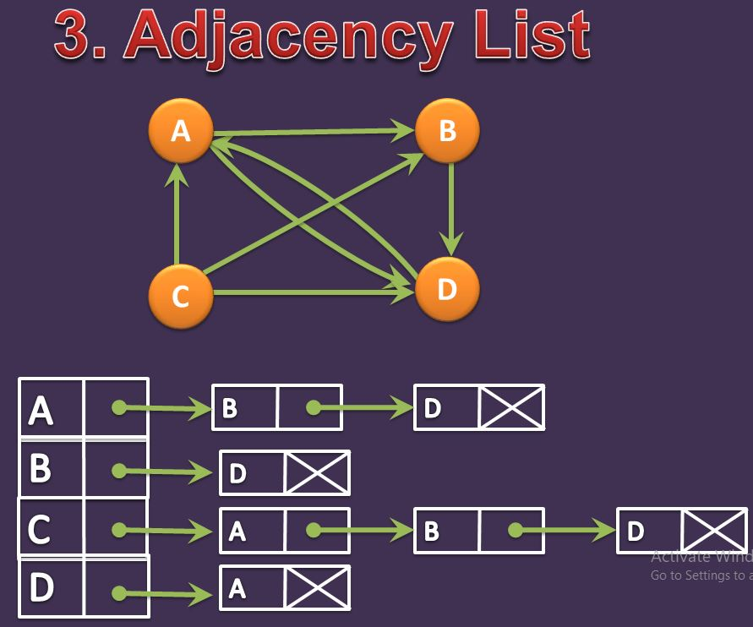
Linked list Representation

Slide 35
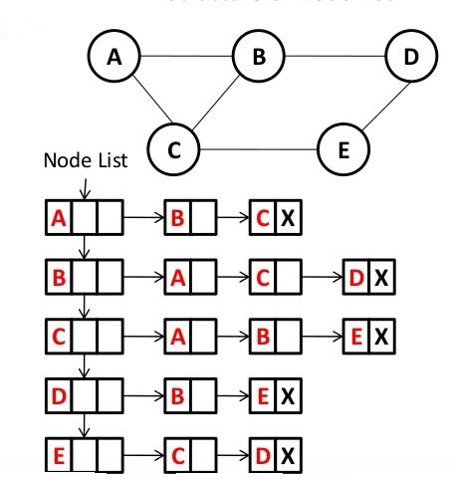
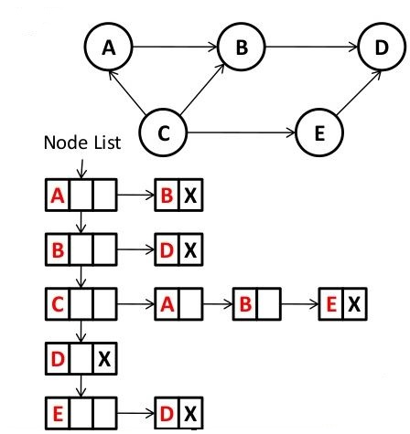
3. Adjacency List of undirected graph
3. Adjacency List of directed graph

Slide 36
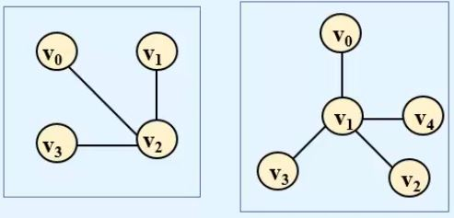
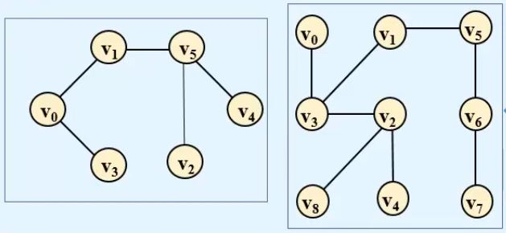
Tree:
A connected graph is a tree if there are no cycle in it.
A tree with n vertices has exactly n-1 edges.
Trees

Slide 37
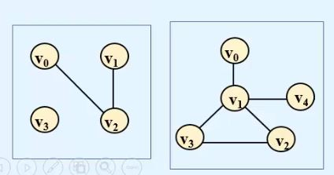
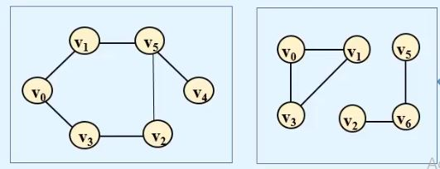
Not Trees

Slide 38
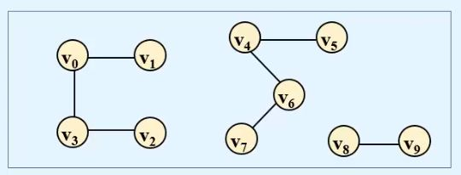
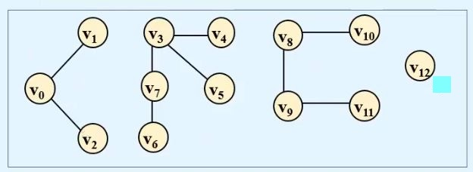
Forest:
A forest is a disjoint union of trees.
In a forest, there is at most one path between any two vertices.
In this forest there are 3 Trees.
In this forest there are 4 Trees.

Slide 39
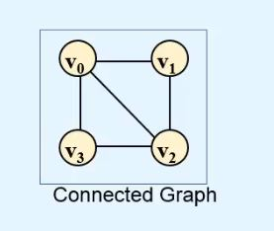
Spanning Tree:
Sub graph T of connected graph G is a spanning tree of G.
Where,
T should contains all the vertices of G.
T should be a Tree.
‘G’

Slide 40
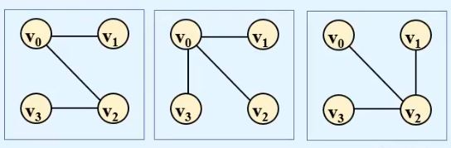
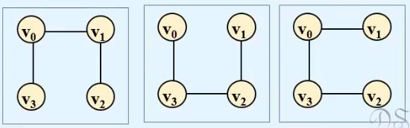
Many possible Spanning Trees of connected graph G are as follows:

Slide 41
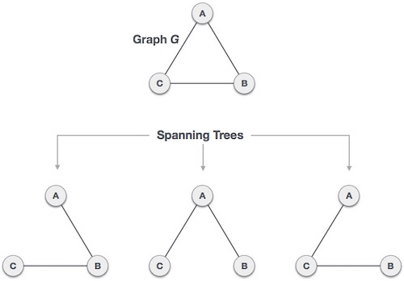

Slide 42
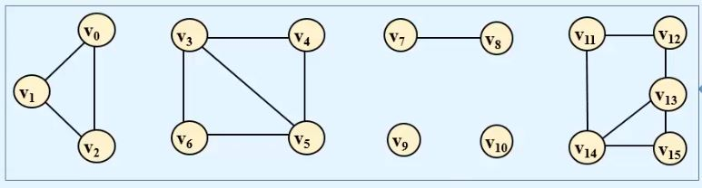
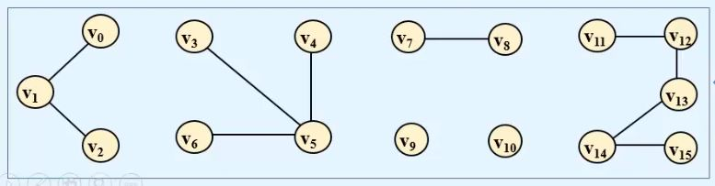
Spanning Forest:
A spanning forest is a sub graph that consists of a spanning tree corresponding to each connected component.
Disconnected Graph G
A Spanning Forest of G

Slide 43
What is a Minimum Spanning Tree (MST)?
A minimum spanning tree is a spanning tree in which the sum of the weight of the edges is as minimum as possible.
or
Minimum spanning tree is the spanning tree where the cost is minimum among all the spanning trees.
The cost of the spanning tree is the sum of the weights of all the edges in the tree.
Minimum spanning trees are used for network designs (i.e. telephone or cable networks, water supply networks, and electrical grids). An example is a cable company wanting to lay line to multiple neighborhoods by minimizing the amount of cable laid, so that the cable company will save money.

Slide 44
Another useful application of MST would be finding airline routes. The vertices of the graph would represent cities, and the edges would represent routes between the cities. MST can be applied to optimize airline routes by finding the least costly paths with no cycles.
Properties of MST:
Should have (n-1) edges.
Weight of MST=sum of weight of edges of MST.
Maximum path length between 2 vertices is (n-1).
Only one path from one vertex to another vertex.
Removal of any edge disconnects the graph.

Slide 45

Example1 of Minimum Spanning Tree:
Lets understand the minimum spanning tree with example.
The initial graph is:
The possible spanning trees from the above graph are:

Slide 46





The minimum spanning tree from the above spanning trees is:

Slide 47

Example2 of Minimum Spanning Tree:
Lets understand the minimum spanning tree with example.
The initial graph is:

Slide 48

The total number of spanning trees that can make from above graph is:
The MST for above respective graph is:
10
A
B
20
Fig: MST
C
D
30

Slide 49
Minimum spanning tree, can be constructed using any of the following two algorithms:
1. Kruskal’s algorithm
2. Prim algorithm
Both algorithms differ in their methodology, but both eventually end up with the MST. Kruskal's algorithm uses edges, and Prim’s algorithm uses vertex connections in determining the MST.
Note:
https://www.tutorialspoint.com/data_structures_algorithms/prims_spanning_tree_algorithm.htm
https://www.javatpoint.com/spanning-tree

Slide 50
1. Kruskal’s Algorithm:
Kruskal’s Algorithm is a famous greedy algorithm.
It is used for finding the Minimum Spanning Tree (MST) of a given graph.
To apply Kruskal’s algorithm, the given graph must be weighted, connected and undirected.
To understand Kruskal's algorithm let us consider the following examples.
https://www.gatevidyalay.com/kruskals-algorithm-kruskals-algorithm-example/

Slide 51
Kruskal’s Algorithm Implementation:
The implementation of Kruskal’s Algorithm is explained in the following steps:
Step-01:
Sort all the edges from low weight to high weight.
Step-02:
Take the edge with the lowest weight and use it to connect the vertices of graph.
If adding an edge creates a cycle, then reject that edge and go for the next least weight edge.
Step-03:
Keep adding edges until all the vertices are connected and a Minimum Spanning Tree (MST) is obtained

Slide 52

Example 1:
Construct the minimal spanning tree for the graph shown below using Kruskal’s Algorithm.
Solution:
Arrange all the edges in increasing order of their cost:

Slide 53

The stages in Kruskal’s algorithm for minimal spanning tree is as follows:

Slide 54



Slide 55



Slide 56

Minimum Spanning Tree

Slide 57

Example 2:
Construct the minimal spanning tree for the graph shown below using Kruskal’s Algorithm.
Solution:
Arrange all the edges in increasing order of their cost:

Slide 58

The stages in Kruskal’s algorithm for minimal spanning tree is as follows:

Slide 59



Slide 60



Slide 61


Slide 62



Minimum Spanning Tree

Slide 63

Example 3: DO THIS QUESTION BY YOURSELF
Construct the minimal spanning tree for the graph shown below using Kruskal’s Algorithm. (show all necessary steps).
Hint:
Remove all loops and parallel edges from the given graph.
In case of parallel edges, keep the one which has the least cost associated and remove all others.

Slide 64


Create a set of edges and weight, and arrange them in an ascending order of weightage (cost) like this:
Your final minimum spanning tree should look like this:

Slide 65
2. Prim algorithm:
Prim’s Algorithm is a famous greedy algorithm.
It is used for finding the Minimum Spanning Tree (MST) of a given graph.
To apply Prim’s algorithm, the given graph must be weighted, connected and undirected.

Slide 66
Prim’s Algorithm Implementation:
The implementation of Prim’s Algorithm is explained in the following steps:
Step-01:
Randomly choose any vertex.
The vertex connecting to the edge having least weight is usually selected.
Step-02:
Find all the edges that connect the tree to new vertices.
Find the least weight edge among those edges and include it in the existing tree.
If including that edge creates a cycle, then reject that edge and look for the next least weight edge
Step-03:
Keep repeating step-02 until all the vertices are included and Minimum Spanning Tree (MST) is obtained.

Slide 67

Example 1:
Construct the minimum spanning tree (MST) for the given graph using Prim’s Algorithm.
Solution:
Following are the steps to find the minimum spanning tree of above graph using prim algorithm.

Slide 68


Step 1:
In case of parallel edges, keep the one which has the least cost associated and remove all others.

Slide 69
Step 2: Choose any arbitrary node as root node.
In this case, we choose S node as the root node of Prim's spanning tree. This node is arbitrarily chosen, any node can be the root node.
Step 3: Check outgoing edges and select the one with less cost.
After choosing the root node S, we see that S,A and S,C are two edges with weight 7 and 8, respectively. We choose the edge S,A as it is lesser than the other.

Slide 70


Slide 71

Now, the tree S-7-A is treated as one node and we check for all edges going out from it. We select the one which has the lowest cost and include it in the tree.

Slide 72

After this step, S-7-A-3-C tree is formed. Now we'll again treat it as a node and will check all the edges again. However, we will choose only the least cost edge. In this case, C-3-D is the new edge, which is less than other edges' cost 8, 6, 4, etc.

Slide 73

After adding node D to the spanning tree, we now have two edges going out of it having the same cost, i.e. D-2-T and D-2-B. so choose any one edge.

Slide 74

So the final minimum spanning tree is as follows:

Slide 75

Example 2:
Construct the minimum spanning tree (MST) for the given graph using Prim’s Algorithm.
Following are the steps to find the minimum spanning tree of above graph using prim algorithm.

Slide 76

Step 1:
Choose any arbitrary node as root node. Here root node is 6

Slide 77

Step 2:

Slide 78

Step 3:

Slide 79

Step 4:

Slide 80

Step 5:

Slide 81

Step 6:
fig: final minimum spanning tree

Slide 82

DO THIS QUESTION BY YOURSELF
Example 3:
Construct the minimal spanning tree for the graph shown below using Prim’s algorithm. (show all necessary steps).

Slide 83

The final minimum spanning tree should look like this

Slide 84

DO THIS QUESTION BY YOURSELF
Example 4:
Using Prim’s Algorithm, find the cost of minimum spanning tree (MST) of the given graph.(show all necessary steps).

Slide 85


The final minimum spanning tree should look like this:

Slide 86

Difference Between Prim’s and Kruskal’s Algorithm:
Some important concepts based on them are
Concept-01: If all the edge weights are distinct, then both the algorithms are guaranteed to find the same MST.
Example-
Consider the following example
Here, both the algorithms on the above given graph produces the same MST as shown.

Slide 87




Concept-02: If all the edge weights are not distinct, then both the algorithms may not always produce the same MST. However, cost of both the MST would always be same in both the cases.
Example-
Consider the following example
Here, both the algorithms on the given graph produces different MST as shown but the cost is same in both the cases.

Slide 88
Traversing a Graph/Graph Traversal Algorithm:
Traversing the graph means examining/visiting all the nodes or vertices of the graph.
There are two standard methods by using which, we can traverse the graphs i.e.
1. Breadth First Search/Traversal (BFS)
2. Depth First Search/Traversal (DFS)

Slide 89
During the execution of these algorithms , each node N of G will be in one of three states , called the status of N, as follows:
a. STATUS = 1 (Ready state):
The initial state of the node N.
b. STATUS = 2 (Waiting state):
The node N is on the QUEUE or STACK, waiting to be processed.
c. STATUS = 3 (Processed state):
The node N has been processed.

Slide 90
1. Breadth First Search/Traversal (BFS):
There are many ways to traverse graphs. BFS is the most commonly used approach.
BFS is a traversing algorithm where you should start traversing from a selected node (source or starting node) and traverse the graph layer wise thus exploring the neighbor nodes (nodes which are directly connected to source node). You must then move towards the next-level neighbor nodes.
As the name BFS suggests, you are required to traverse the graph breadthwise as follows:
First move horizontally and visit all the nodes of the current layer
Move to the next layer

Slide 91

The BFT will use a queue as an auxiliary structure to hold nodes for future processing.
Consider the following diagram.

Slide 92
Breadth first traversal algorithm:
This algorithm executes a BFT on graph G beginning at a starting node A.
Initialize all nodes to the ready state (STATUS = 1).
Put the starting node A in QUEUE and change its status to the waiting state (STATUS = 2).
3. Repeat the following steps until QUEUE is empty:
Remove the front node N of QUEUE. Process N and change the status of N to the processed state (STATUS = 3).
Add to the rear of QUEUE all the neighbors of N that are in the ready state (STATUS = 1) and change their status to the waiting state (STATUS = 2).
4. Exit.

Slide 93
2. Depth First Search/Traversal (DFS):
Depth first search (DFS) algorithm starts with the initial node of the graph G, and then goes to deeper and deeper until we find the goal node. The algorithm, then backtracks from the dead end towards the most recent node that is yet to be completely unexplored.
The data structure which is being used in DFS is stack. The process is similar to BFS algorithm. In DFS, the edges that leads to an unvisited node are called discovery edges while the edges that leads to an already visited node are called block edges.

Slide 94


Slide 95
Depth first traversal algorithm:
This algorithm executes a DFT on graph G beginning at a starting node A.
Initialize all nodes to the ready state (STATUS = 1).
Push the starting node A into STACK and change its status to the waiting state (STATUS = 2).
Repeat the following steps until STACK is empty:
Pop the top node N from STACK. Process N and change the status of N to the processed state (STATUS = 3).
Push all the neighbors of N that are in the ready state (STATUS = 1) and change their status to the waiting state (STATUS = 2).
4. Exit.

Slide 96


Example:
Consider the graph shown below. Traverse the graph shown below in breadth first order and depth first order.

Slide 97


Slide 98



Slide 99



